Slide 1

Renewable energy-based
hydrogen production
Supervisor : Dr. Nitin D. Chaturvedi

Slide 2

Introduction
The global energy landscape is rapidly evolving, with an increasing emphasis on sustainability and reduced environmental impact.
Fossil fuels, our primary energy source for decades, are facing limitations, including greenhouse gas emissions and finite reserves.
This presentation delves into the realm of renewable energy-based hydrogen production, addressing the pressing need for cleaner energy sources.
Hydrogen is a clean and sustainable fuel that can be used to generate electricity, power vehicles, and produce heat without emitting greenhouse gases.
Renewable energy sources, such as solar, wind, and geothermal, can be used to produce hydrogen in a sustainable way.
The development of renewable energy-based hydrogen production technologies is essential for the transition to a clean energy economy.

Slide 3

Motivation
Our motivation arises from the urgent necessity to transition to sustainable energy solutions that mitigate environmental harm and meet growing energy demands.
The aim is to explore and compare renewable energy-based methods for hydrogen production, which have the potential to revolutionize our energy systems.
Fossil fuels pose a dual challenge: environmental degradation and the inevitability of resource depletion.
Hydrogen stands out as a promising energy carrier, with its capacity for versatile use and potential for minimal environmental impact.
Our research seeks to contribute to this transition by assessing three renewable energy-based configurations for hydrogen production.

Slide 4
Objectives
To compare and contrast the energy and exergy efficiencies of three renewable energy-based hydrogen production methods: solar PV, biomass gasification, and geothermal.
To discuss the technical and economic challenges of each method. Evaluation of their efficiency, environmental sustainability, and economic feasibility.
To identify the most promising renewable energy-based hydrogen production method for future development.

Slide 5
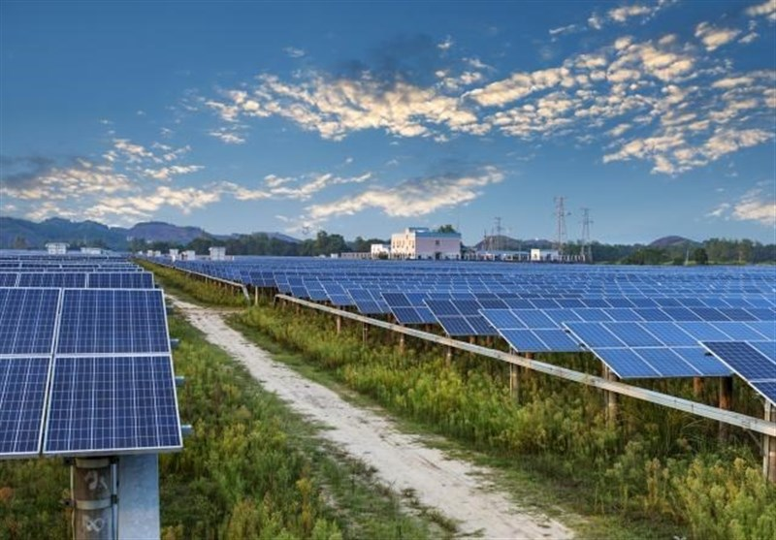
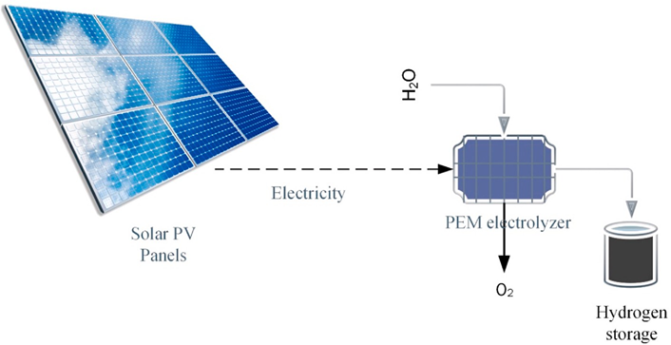
Solar PV
The utilization of solar energy for hydrogen production is a promising area of research, with the potential to address the challenges of climate change and energy security. Solar energy can be used to produce hydrogen through two main pathways: direct solar water splitting and solar-driven electrolysis.
Solar-driven electrolysis: This process uses solar energy to generate electricity, which is then used to power an electrolyzer. Electrolyzers split water into hydrogen and oxygen using electrical energy. Solar-driven electrolysis is a more mature technology than direct solar water splitting, and it is already being used to produce hydrogen on a commercial scale.

Slide 6
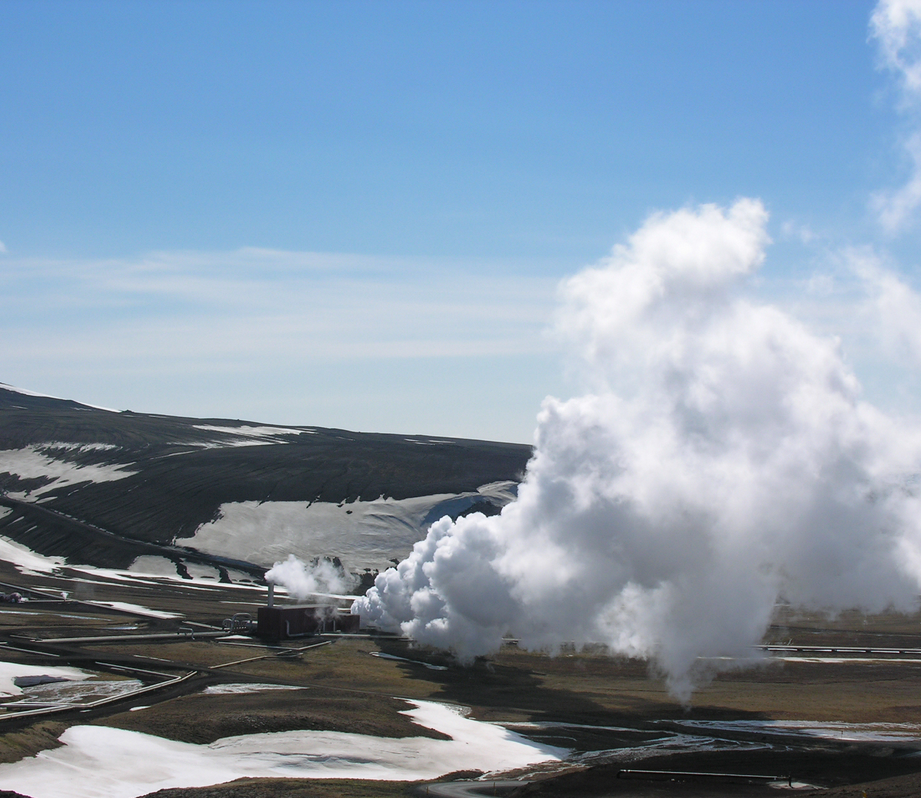
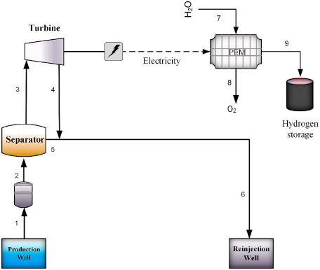
Geothermal energy
Geothermal energy is the heat energy generated and stored in the Earth. Geothermal energy can be used to produce hydrogen through a variety of methods, including:
Direct geothermal hydrogen production: This process uses geothermal fluids to heat water to a high temperature, which then causes the water to split into hydrogen and oxygen.
Geothermal-assisted electrolysis: This process uses geothermal energy to generate electricity, which is then used to power an electrolyzer.
Geothermal-based hydrogen production is a promising method because it can provide a reliable and sustainable source of hydrogen.

Slide 7
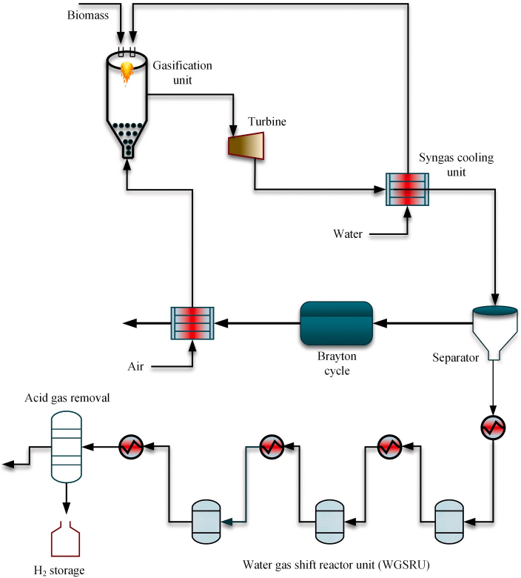
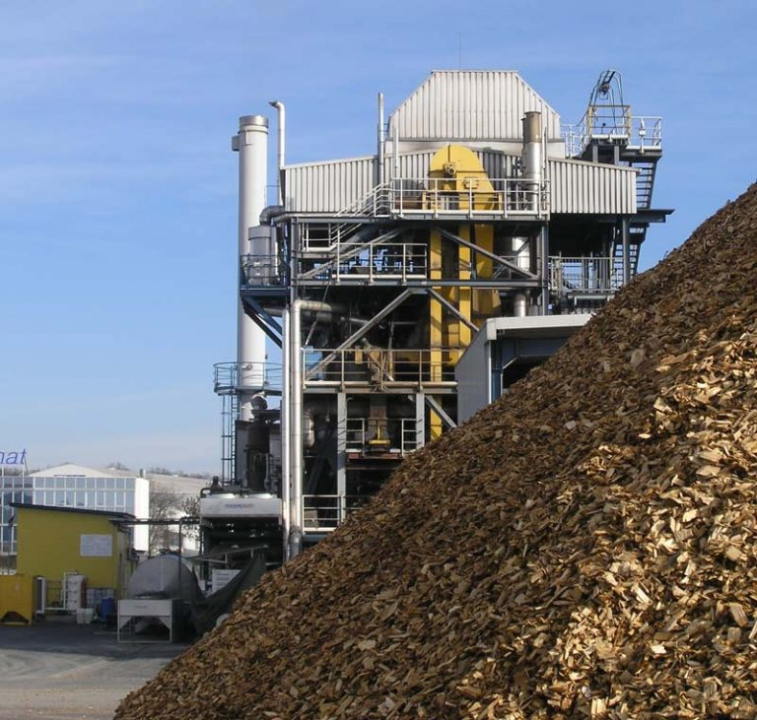
Biomass gasification
Biomass gasification is a process that converts biomass (such as wood, agricultural waste, or municipal solid waste) into a syngas that is rich in hydrogen. The syngas can then be cleaned and upgraded to produce pure hydrogen. Biomass gasification is a promising method for hydrogen production because it can utilize a variety of feedstocks and produce a relatively high-quality hydrogen product.

Slide 8
Biomass gasification- most efficient, but can produce harmful emissions and the cost of biomass feedstocks can be high.
Geothermal energy and Solar PV are clean and renewable, but less efficient
Method | Energy efficiency | Exergy efficiency | Technical challenges | Economic challenges
Solar PV | 16.95% | 17.45% | Low efficiency of solar PV electrolyzers | High cost of solar PV electrolyzers
Biomass gasification | 53.60% | 49.80% | Harmful emissions from biomass gasification | High cost of biomass feedstocks
Geothermal energy | 10.40% | 10.20% | Geographical limitations of geothermal power plants | Cost of geothermal energy can vary depending on the location

Slide 9
Biomass Gasification Modelling
The aim of this process is to produce hydrogen gas from biomass.
The following below are the stages involved in biomass gasification process:
Drying: This is done in order to reduce moisture content of the feed (biomass)
Decomposition and pyrolysis: This involves transformation of biomass into its constituent elements at elevated temperature.
Gasification: This includes all the reactions that results in the production of hydrogen gas like water gas shift reaction etc.
Separation: Typically involves the separation of produced hydrogen from unreacted feed and by-products.

Slide 10
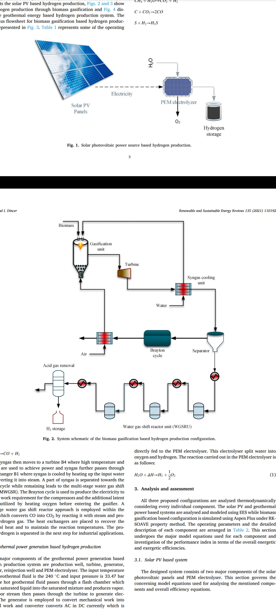

Slide 11

Process Simulation
We have used Aspen Plus for Process Simulation
Process Components

Slide 12
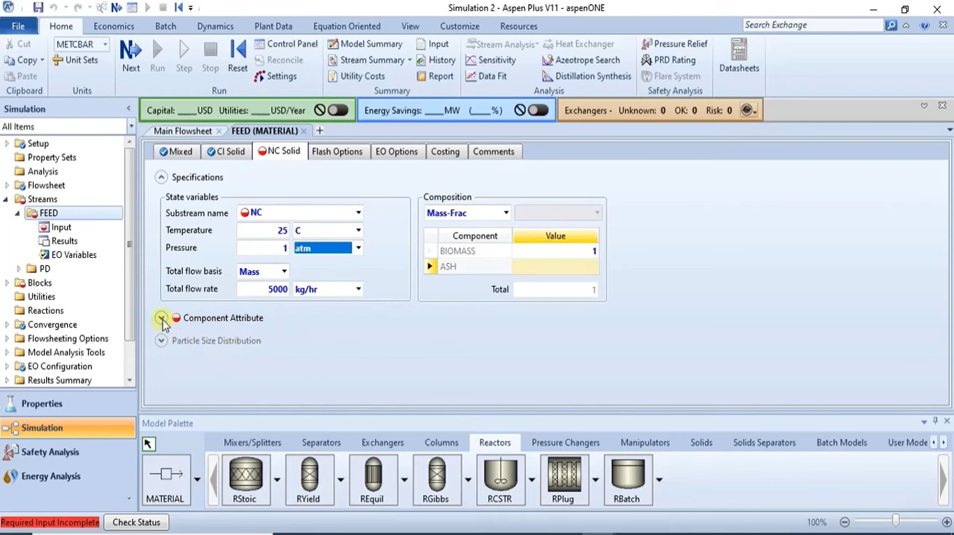
We have used Peng- Robinson as Process Method
Feed Properties

Slide 13
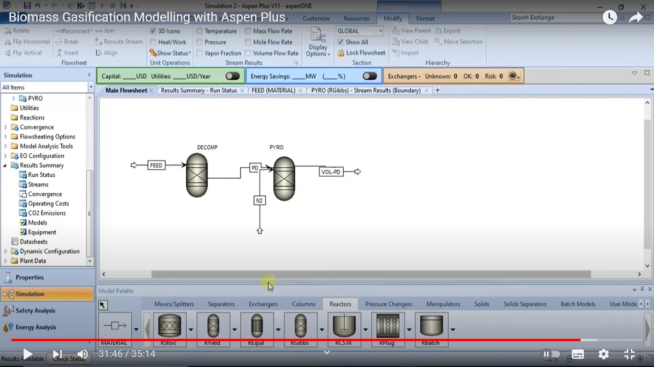
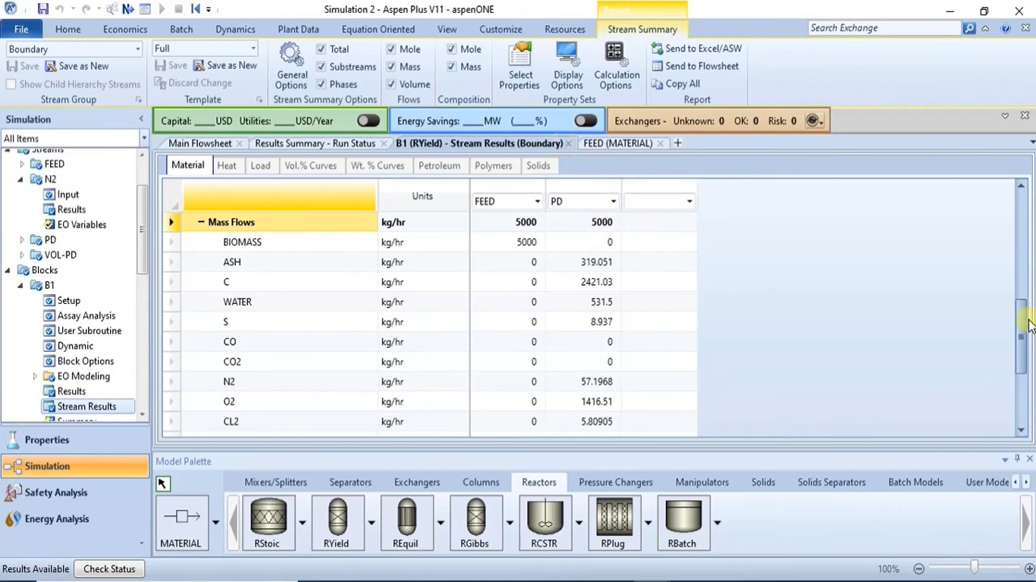
Decomposition and Pyrolysis

Slide 14
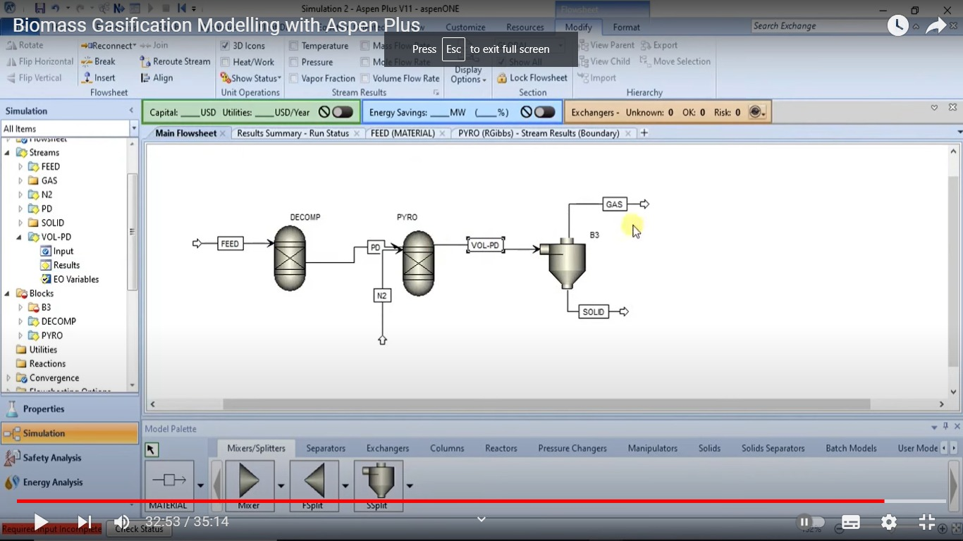
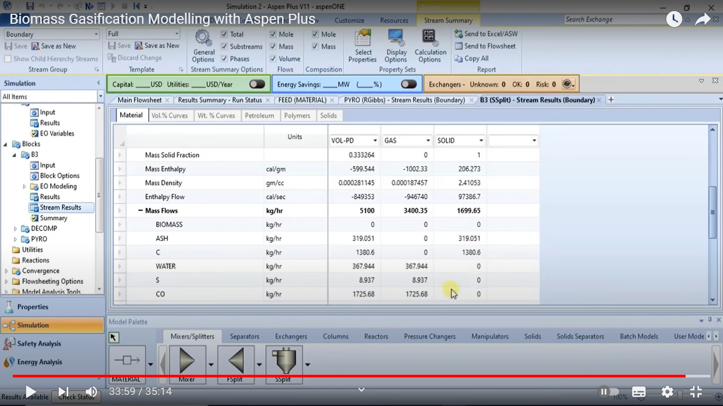
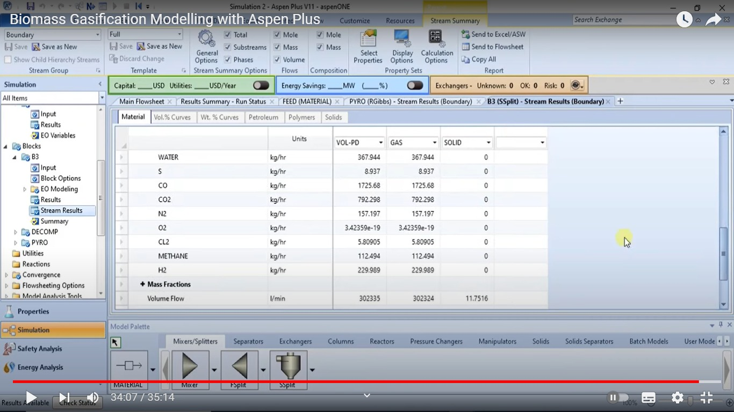
Separating gaseous components from solids

Slide 15
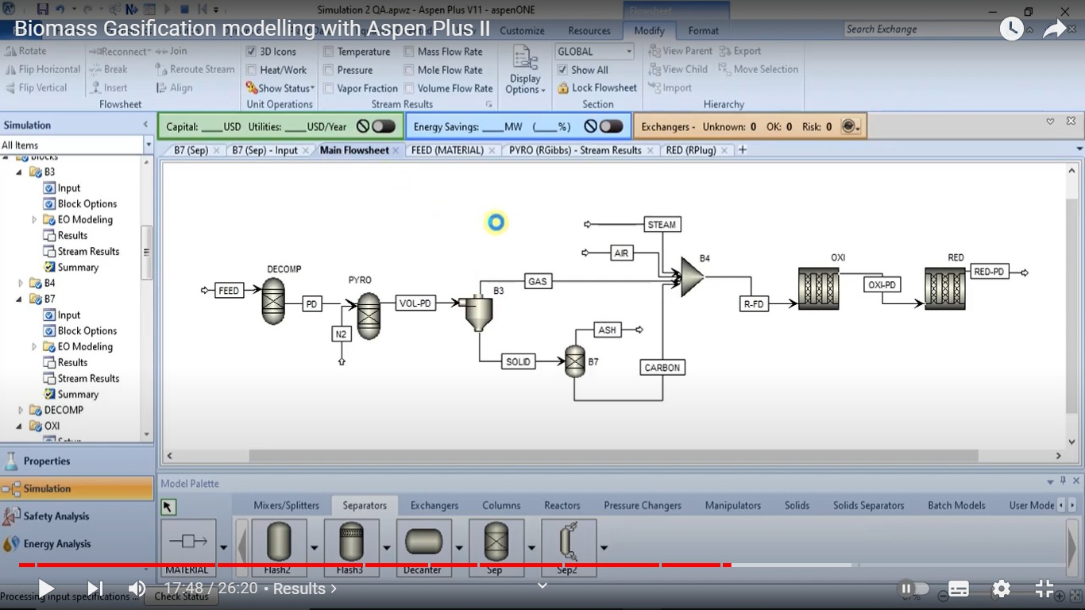

Slide 16
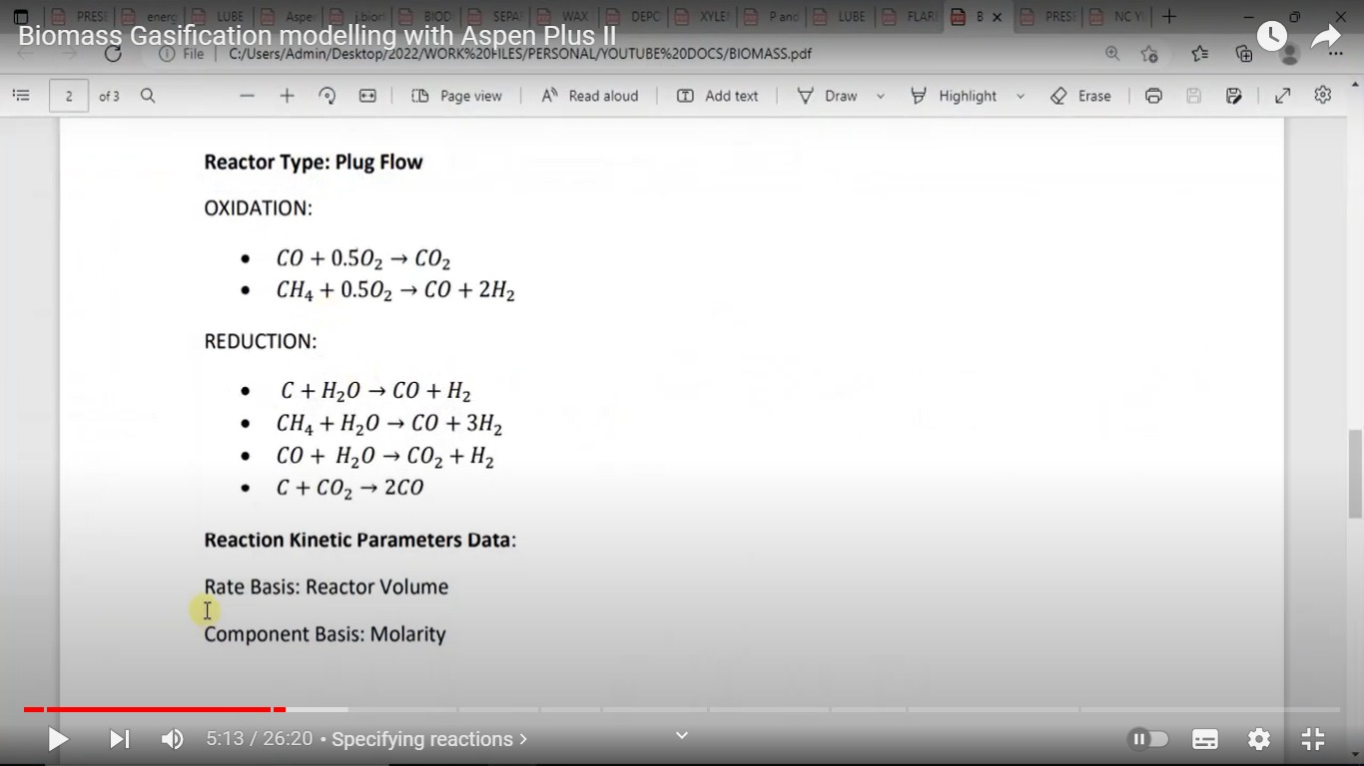

Slide 17
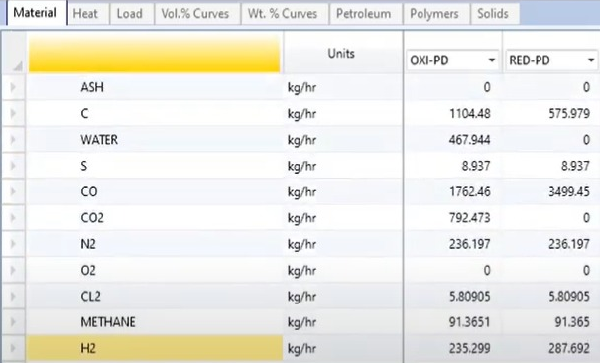
Results obtained after oxidation and reduction reaction

Slide 18
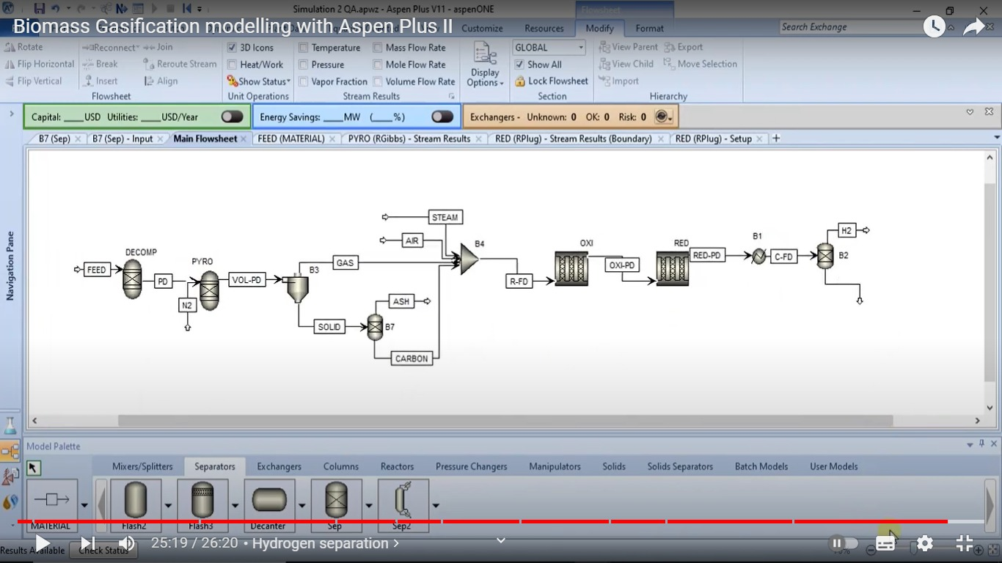
Separation Hydrogen from unreacted-feed and by-products

Slide 19
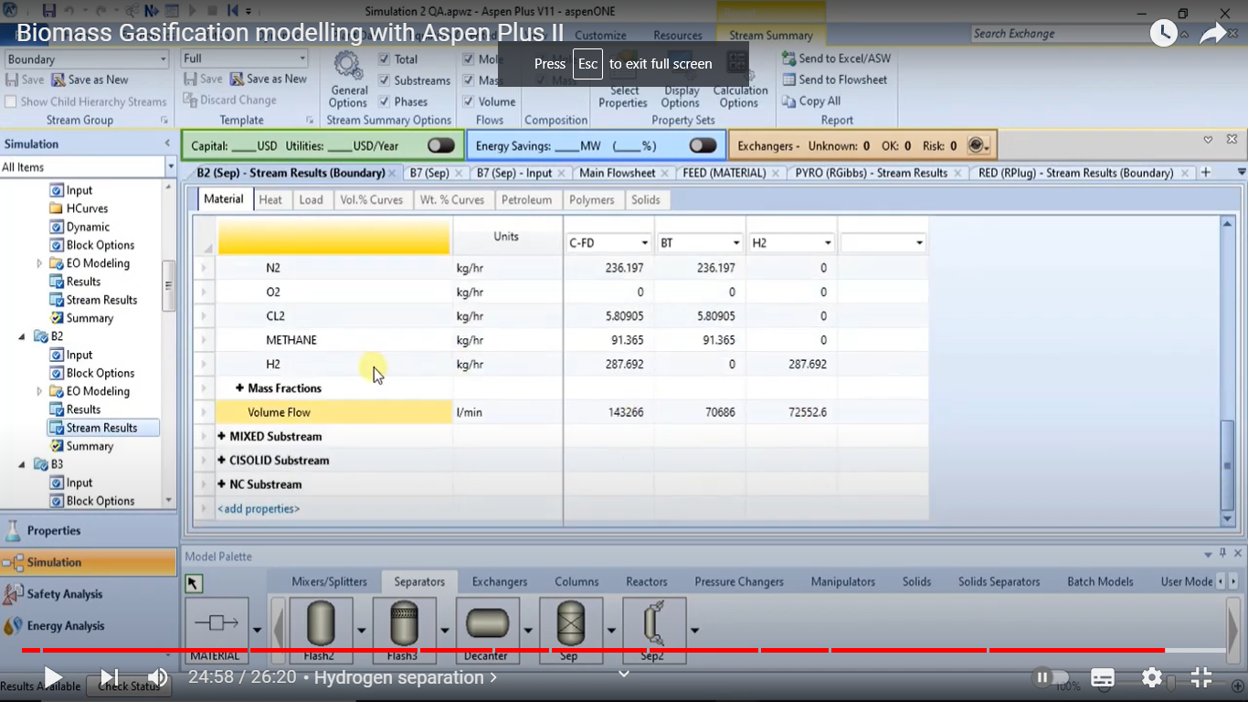
Result and Discussion

Slide 20
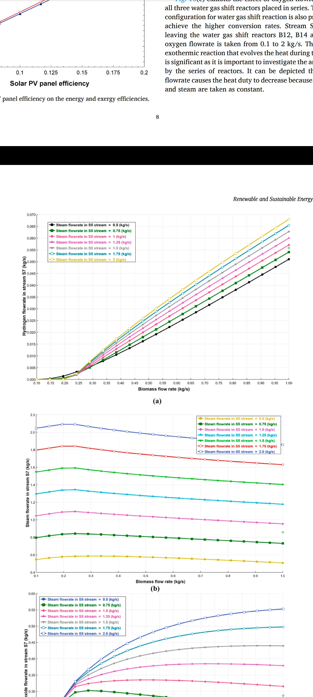
It exhibits the effect of biomass and steam flowrates on the
hydrogen production capacities

Slide 21
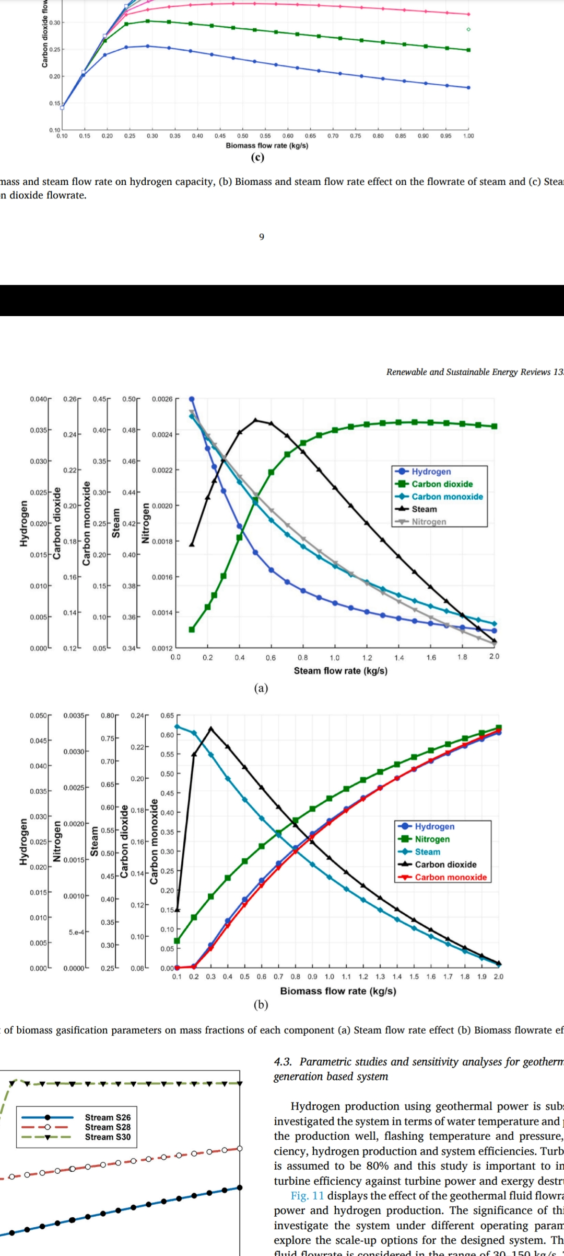
It exhibits the effect of steam input flow rate on the mass fraction of each components of syngas at constant biomass flowrate

Slide 22
It exhibits the effect of biomass input flow rate on the mass fraction of each components of syngas at constant steam flowrate

Slide 23
Conclusion
This study develops three different configurations for renewable energy-based hydrogen production methods including solar PV, Biomass gasification and geothermal power generation.
It proposes a production methods under various source and operating conditions and types of units utilized.
Some key findings of the study are summarized as follows:
The overall energy efficiency of the solar PV based hydrogen production system is 16.95% and hydrogen production rate is found to be 2.26 g/s.
The biomass gasification based hydrogen production system overcomes with the energy efficiency of 53.6% with hydrogen production rate of 79.72 g/s.
Geothermal energy based hydrogen production system is finalized with the energy efficiency of 10.45% and system is capable of producing 32.02 g/s of hydrogen.

Slide 24
References:
Hosseini SE, Andwari AM, Wahid MA, Bagheri G. A review on green energy potentials in Iran.
Renew Sustain Energy Rev 2013;27:533–45.
Chiari L, Zecca A. Constraints of fossil fuels depletion on global warming projections. Energy Pol 2011;39:5026–34.
Collier K, Hahn D, Marion B. Solar hydrogen production demonstration. Conf Rec IEEE Photovolt Spec Conf 2002:635–9. https://doi.org/10.1109/ pvsc.1991.169288
Ud Din Z, Zainal ZA. Biomass integrated gasification–SOFC systems: technology overview. Renew Sustain Energy Rev 2016;53:1356–76.

Slide 25
THANK YOU

